Slide 1
Deep Audio Denoiser using Deep Learning
Kshitij Kumar (DSAI) (201020426)
Rajeev Ranjan (DSAI) (201020444)
Anand Kumar Singh (ECE) (201010209)
Date: 24/03/2023
International Institute of Information Technology, Naya Raipur

Slide 2
Introduction
In hearing aids, the presence of bad noise degrades hearing intelligibility of human speech greatly.
However, removing the babble without creating artifacts in human speech is a challenging task in a low SNR environment.
Here, we sought to solve the problem by finding a ‘mapping’ between noisy speech spectra and clean speech spectra via supervised learning.
Specifically, we propose fully Convolutional Neural Networks, to improve the quality of noise.
*
International Institute of Information Technology, Naya Raipur
‹#›

Slide 3
Literature Review
Conventional methods – These methods involve estimating the noise to achieve denoising. Examples of these methods are spectral subtraction and Wiener filtering. Some previously existing denoising systems relied on spectrogram-domain statistical signal processing methods, followed more recently by spectrogram factorization-based methods.
Deep learning-based methods – These more recent methods attempt to model the nonlinear relationship between noisy and clean speech signals via a deep neural network (DNN).
*
International Institute of Information Technology, Naya Raipur
‹#›

Slide 4
Problem Statement
Given a noisy input signal, we aim to build a statistical model that can extract the clean signal (the source) and return it to the user.
Here, we focus on source separation of regular speech signals from ten different types of noise often found in an urban street environment.
*
International Institute of Information Technology, Naya Raipur
‹#›

Slide 5
Dataset Description
For the problem of speech denoising, we used two popular publicly available audio datasets.
The Mozilla Common Voice (MCV) - The dataset contains as many as 2,454 recorded hours, spread in short MP3 files. The dataset contains vast variability of speakers and recordings of men and women from a large variety of ages and accents.
The UrbanSound8K dataset - It contains small snippets (<=4s) of sounds. However, there are 8732 labeled examples of ten different commonly found urban sounds such as air conditioner, car horn, children playing, dog bark, drilling, engine idling, gun shot, jackhammer, siren and street music.

Slide 6
Data Preprocessing
For audio processing, we know that Neural Network will extract relevant features from the data. However, before feeding the raw signal to the network, we need to get it into the right format.
Feature extractors technique like SIFT (Scale Invariant Feature Transform) and SURF (Speeded Up Robust Feature).
In SIFT, Lowe approximated Laplacian of Gaussian with Difference of Gaussian for finding scale-space is used but SURF goes a little further and approximates LoG with Box Filter.

Slide 7
Deep Learning Architecture
Model is based on symmetric encoder-decoder architectures.
Both components contain repeated blocks of Convolution, ReLU, and Batch Normalization.Network contains 16 of such blocks.
There are skip connections between some of the encoder and decoder blocks. It is similar to ResNets, the skip connections speed up convergence and reduces the vanishing of gradients.

Slide 8
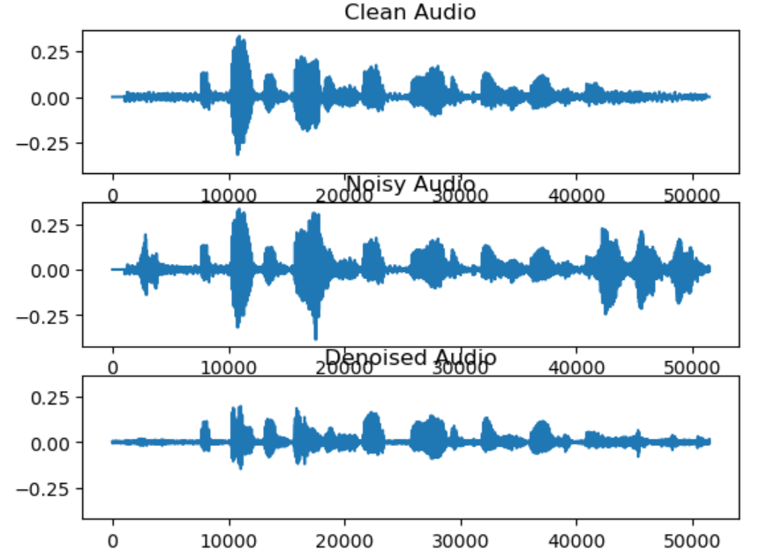
Results

Slide 9
Results
Training Loss | Training RMSE | Validation loss | Validation RMSE
0.1382 | 0.801 | 0.1616 | 0.852

Slide 10
Conclusion
Audio denoising is a long-standing problem.
By following the approach described here, we reached acceptable results with relatively small effort.
The benefit of a lightweight model makes it interesting for edge applications.
We set up an experiment to denoise human speech from babble noise which is a major discomfort to the users of hearing aids.
Through experiments, we demonstrated that CNN can yield similar or better performance with much lesser number of model parameters.

Slide 11
Overleaf link
https://www.overleaf.com/3166985124jvbmjqhgdgfb

Slide 12

THANK YOU!
..
Dr. Shyama Prasad Mukherjee International Institute of Information Technology, Naya Raipur
*
International Institute of Information Technology, Naya Raipur
‹#›

